Slide 1
Talking about E: 5 Desafios da transição energética em Portugal
Prof. Dr. Lucila de Almeida Abreu Chair in ESG Impact, NOVA School of Law Part-time Professor, Florence School of Regulation,
European University Institute
Subtitle, date or author second line
Notes:
Primeiramente, Agradecer ao ESG Women initiative – Alice, Filipa e Rita, Deloiitte pelo reconheciment
Segundo, pedir-lhes desde já uma bocado de paciencia pelo:
meu portugues nao muito portugues,
e meu deselnagante excess de anglo-phonismo. Mesmo depois de 15 anos a trabalhar direta e indiretametne na bolha e bruxelas, ingles nao deixou de ser minha lingua de trabalho, nem o portugues brasileiro dexiou de ser minha lingua de orifgem.

Slide 2
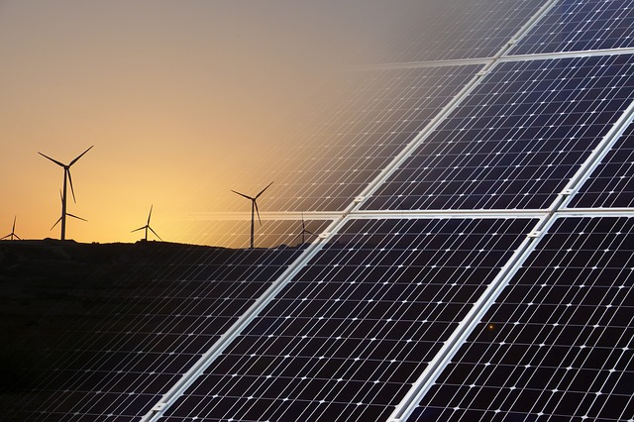
Talking about E:
5 Desafios da transição energética em Portugal
Scope:
Energy transition from the perspective of the energy crisis and the electricity market reform proposed by EC;
Measures to lead the increase of generation of renewables and commercialization;
Known-unknown legal challenges
Structure:
Challenge 1 – Renewables Targets
Challenge 2 – Marginal Prices and Crisis
Challenge 3 – Power Purchase Agreements
Challenge 4 – Contracts for Differences
Challenge 5 – Energy sharing
Notes:
Primeiro quanto ao tema e a importancia de falar dos 5 desafios da transicao energetica, o que agradeco pela escolha e

Slide 3
Challenge 1
The renewables targets

Slide 4
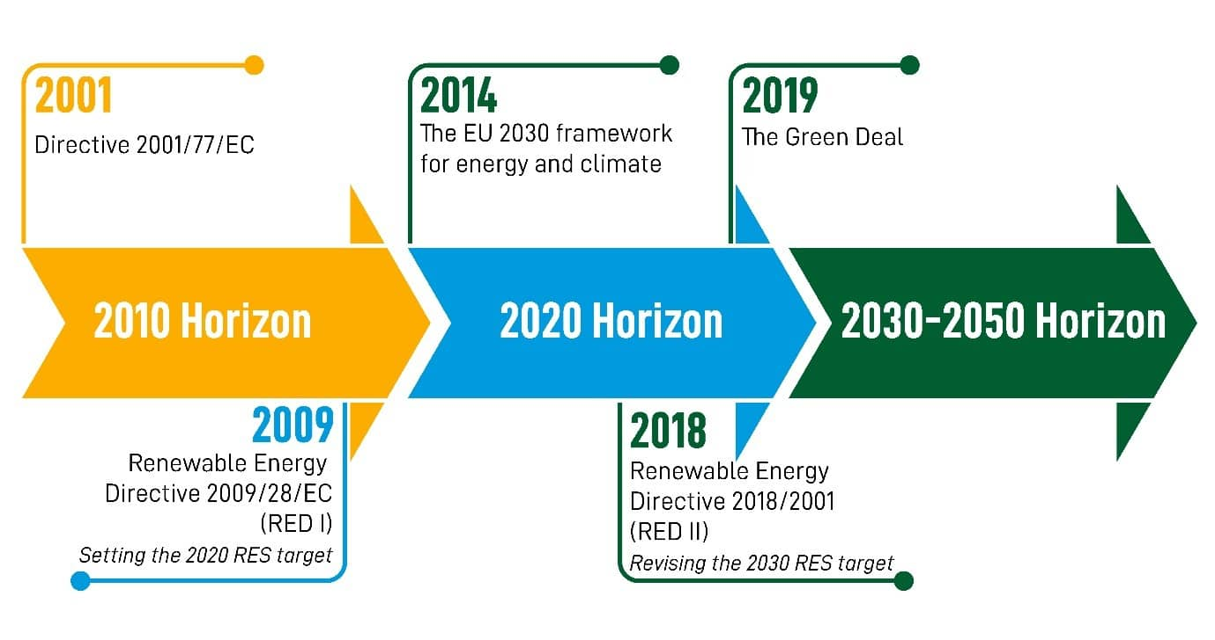
Renewables targets
From 2020 Horizon to REPowerEU
National Energy and Climate Plans:
EU countries set out how they plan to meet these 2030 targets and the general course of their renewable energy policy in national energy and climate plans.
Portugal review of the NECP is now open for prior consultation
Proposal - Union's gross final consumption of energy in 2030 is at least 40%
On 18 May 2022, REPowerEU increased to 45%
RES Support Schemes:
- RES support schemes are still allowed but must provide (i) incentives for market integration and (ii) responding to market signals in an open, transparent, competitive, non-discriminatory, and cost-effective.
- New State Aid Guidelines.
- Exceptions for small-scale installation projects are possible.
Art. 3 (1)
Member States shall collectively ensure that the share of energy from renewable sources in the Union's gross final energy consumption in 2030 is at least 32%.

Slide 5
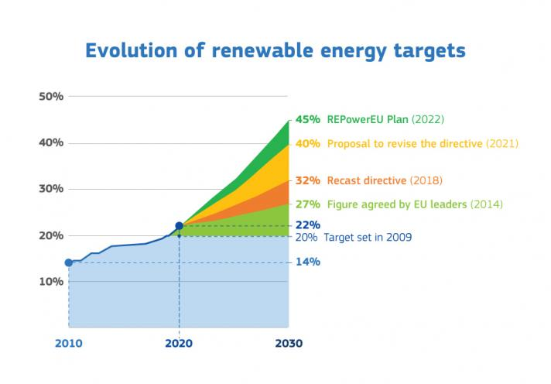
Legal challenge known-unknown
State Sovereignty under Article 194(2)
Known legal challenge – increasing the tension between Article 194(2) and 192(2)(c) TFEU
Article 194(2) – Member State's right to determine the conditions for exploiting its energy resources, it is choice between different energy sources, and the general structure of its energy supply, without prejudice to Article 192(2)(c).
Article 192(2)(c) – special legislative procedures to approve measures significantly affecting a Member State's choice between different energy sources and the general structure of its energy supply.
CJEU´s precedents
Cases T-356/15 Austria v Commission EU:T:2018:439, jugement of 12 July 2018;
C-594/18 P Austria v Commission EU:C:2020:742, jugement of 22 Septembre 2020;
Case C-5/16 Poland v Parliament and Council EU:C:2018:483, judgment of 21 June 2018.

Slide 6
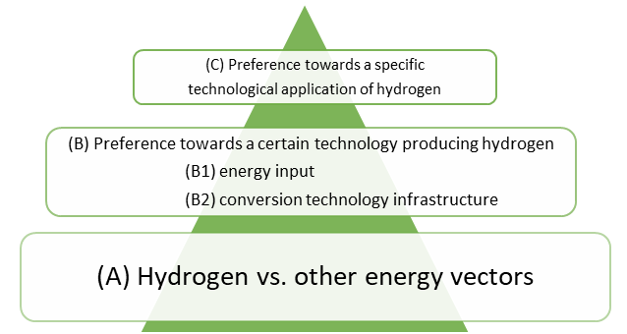
Legal challenges unknown-unknown
Technological neutrality
Neutral Or Not? Measuring Technology Bias In The European Hydrogen Framework (Porcari, Almeida and Thomas, Forthcoming)
The draft RED III and Delegated Regulation are less neutral than RED II.
In particular, it is not neutral under parameter (B2) because it only considers hydrogen produced by electrolysis: “as a principle, liquid and gaseous fuels of non-biological origin are considered renewable when the hydrogen component is produced in an electrolyzer that uses renewable electricity”.
Proportionality principle.

Slide 7
Challenge 2
Marginal Prices

Slide 8
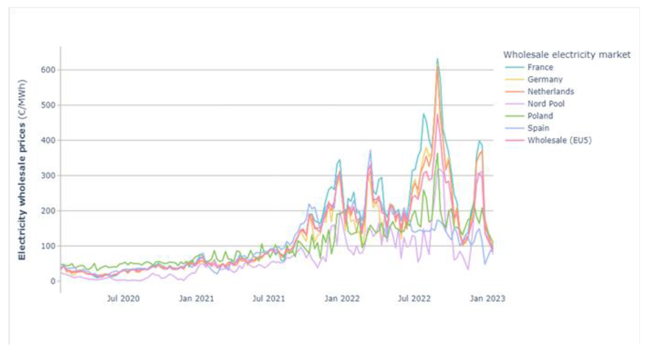
Marginal Prices
The known reasons for the skyrocket in electricity spot markets prices
The EU – mostly
Prices started rising rapidly in the summer of 2021 when the world economy picked up after COVID-19 restrictions were eased;
Russia’s invasion of Ukraine and its weaponization of energy sources by withholding capacities from spot markets have led to substantially lower levels of gas delivery and increased disruptions of gas supply, further driving up the gas prices;
The EU security of supply´s reliance on imported natural gas.

Slide 9
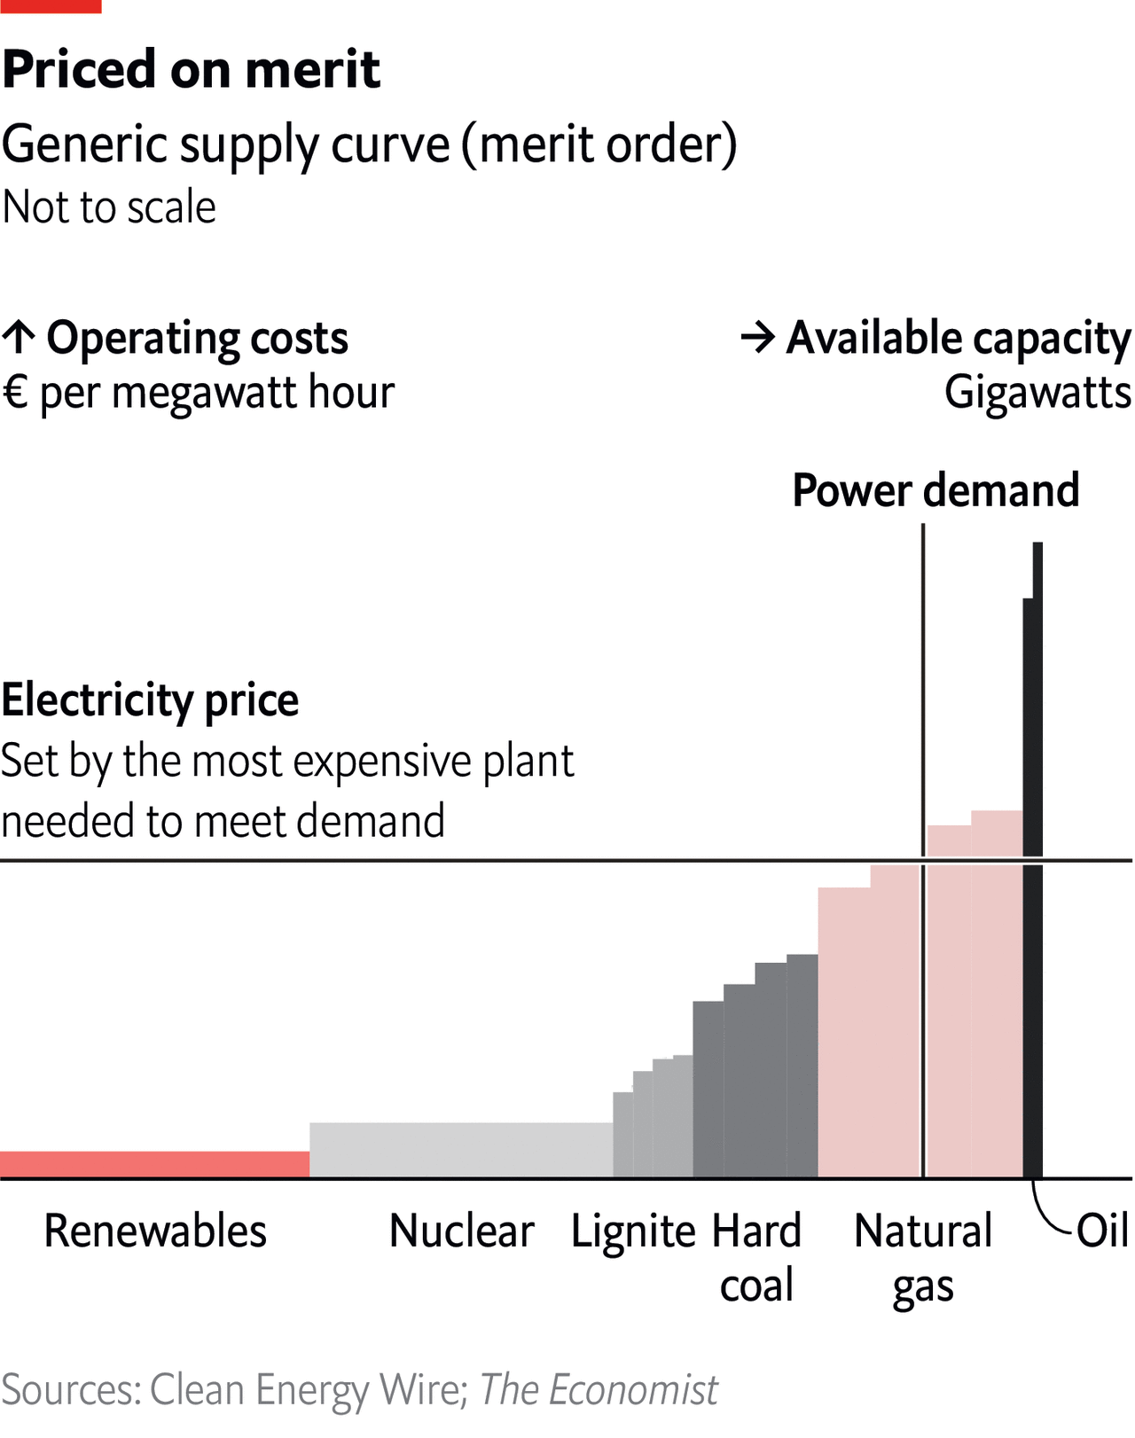
Marginal Prices
The known-unknown reasons for the skyrocket in electricity spot markets prices
Marginal prices - When MWh of gas increased by 100 Euros, a new normal in 2022, the price of electricity produced from natural gas increased by 200 EUR per MWh, and so too all the electricity traded in power exchanges.
The European Commission argues that most public consultation respondents consider that short-term markets are functioning well and do not see an alternative to the marginal pricing model. Liquidity and a level playing field are, however, quoted as weaker elements.
Known-unknown legal challenges - Marginal price might violate EU competition law, Article (Esposito & Almeida 2018, and forthcoming)

Slide 10
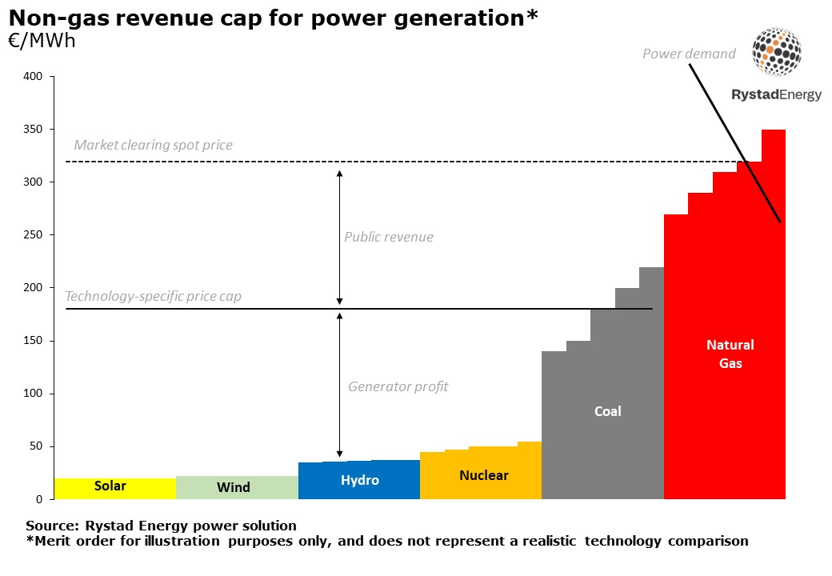
Marginal Prices
Emergence measures
On 30 September 2022, the Council of the European Union agreed to impose a cap on the price market for inframarginal and an EU-wide windfall profits tax on fossil fuel companies to collect and redistribute the energy sector's surplus revenues to final consumers.
The Regulation caps the market revenues at EUR 180/MWh for electricity generators, including intermediaries, that use inframarginal technologies, such as renewables, nuclear, and lignite to produce electricity.
Known legal challenges - measure is a tax, which competence is reserved for national governments, and contests the use of the EU Treaty's Article 122 (Exxon vs. Council)

Slide 11
Challenge 3
Electricity reform and PPAs

Slide 12
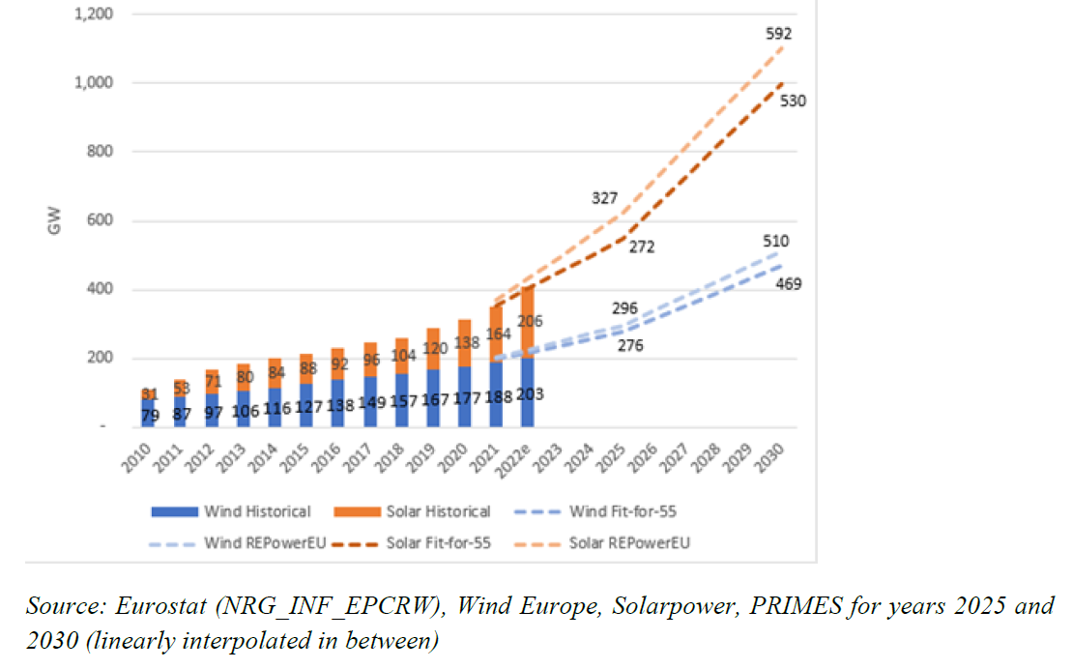
Electricity reform
Expected share of renewable electricity
According to the European Commission Staff Working Document implementing the REPowerEU plan, 592 GW of solar PV capacity and 510 GW of wind capacity are required by 2030 to achieve the 69% share of renewable electricity modeled by the Commission (a gap of 693 GW of capacity);
CEER report found that the volume of supported renewable electricity increased from 257 GW in 2018 to 269 GW in 2019 (a total of 287 GW);
A large share of RES generation has therefore received RES support schemes;
Electricity market reform relies strongly on PPAs, CfD, and sharing to fill 693 GW of capacity by 2030.

Slide 13
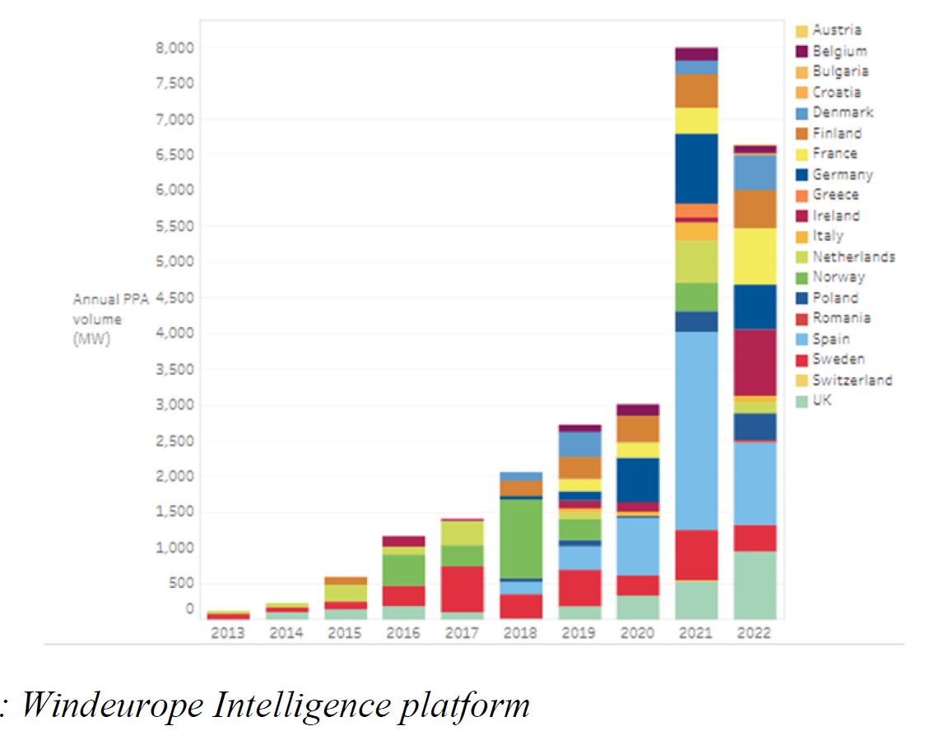
Electricity reform
Power Purchase Agreements (PPAs)
The overall volume of renewables PPAs in Europe (including the UK or Norway) has reached 8 GW in 2021, early data for 2022 indicate a first-ever drop in the volume of such deals (to below 7 GW).
Barriers - the risks associated with a payment default by the potential buyer remain a key obstacle for the signature of PPAs.
It is overoptimistic to think that PPAs would be the key instrument to fill the GAP of 693 GW of capacity.

Slide 14
Challenge 4
Electricity reform and CfDs

Slide 15
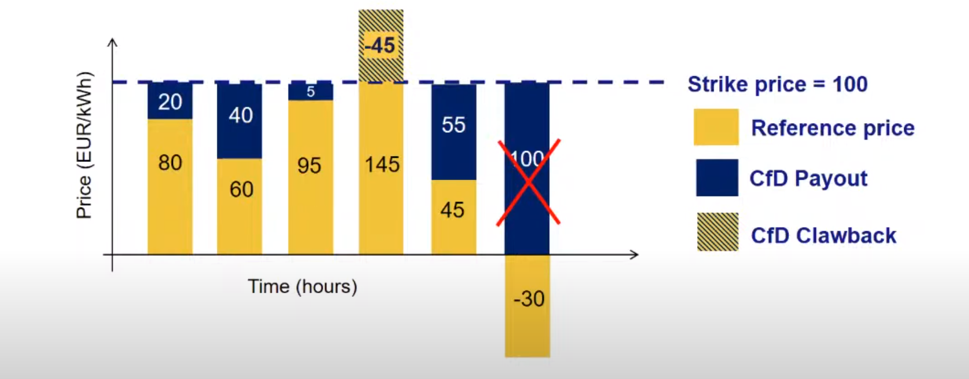
Electricity reform
Contract for Differences (CfDs)
Contract for Difference was first designed as a transitional measure;
A CfD entitles the beneficiary to a payment equal to the difference between a fixed ‘strike’ price and a reference price, such as a market price, per unit of output (also known as a sliding premium);
One-sided CfDs aim to guarantee a minimum price to the producer. This type of contract would, therefore, not address the challenge of excessive remuneration in a high-price environment since there would be no limitation on the revenues (Closer to feed-in premium?);
Two-way CfDs involve payback from beneficiaries to the State for periods during which the reference price exceeds the strike price (back to FiT?)
Unknown-known legal issues:
CfDs might violate the criteria of RED II (and RED III) for renewable schemes concerning the need for market signals;
Many CfDs have territorial restriction clauses.

Slide 16
Challenge 5
Electricity reform and Energy sharing

Slide 17
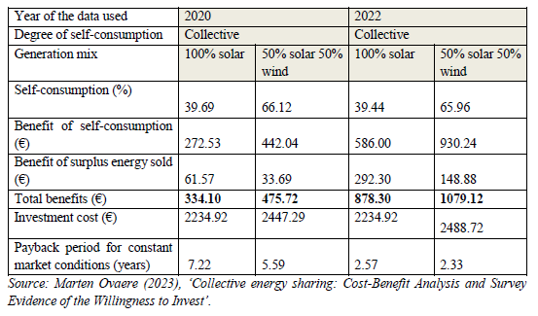
Electricity reform
Energy sharing
Under the current legal framework, consumers without private ownership rights over suitable space have limited possibilities to engage with renewables directly, they need to either find consensus with their neighbors to install solar PV on the roof of their multi-apartment building (collective self-consumption) or be able to invest in an energy community.
In some Member States, wider energy-sharing schemes allowing for collective self-consumption of off-site generation facilities within a local perimeter started emerging51 but not in most as such schemes are not explicitly recognised at EU level.
in Portugal where energy can be shared between 2-20 km radius depending on voltage levels where the self-consumption unit is connected to. See Decreto-Lei n.º 15/2022, de 14 de janeiro | DRE).
Known-known legal issues:
Consumers shall have the right to have injected electricity deducted from their total metered consumption within a set time interval and within the same bidding zone for the purpose of calculating the energy component of their energy bill (back to FiT?).

Slide 18
Takeway
Tremendously challenge - 592 GW of solar PV capacity and 510 GW of wind capacity are required by 2030 to achieve the 69% share of renewable electricity modelled by the Commission.
Balance between the narrow interpretation of the Treaty provides that the Member State's right to determine the conditions for exploiting its energy resources and the EU, and the competence of the Union to pursue a more sustainable energy market, the latter complying with the principle of proportionality.
Ensure emergence measures do not become permanent, with reference to revenue cap.
The contractual design of CfDs and sharing must be monitored to ensure no abuse.
This is dummy text it is not here to be read this is dummy text it is not here to be read
This is dummy text it is not here to be read this is dummy text it is not here to be read

Slide 19
Energy justice – Distributional justice concerns unfairness in sharing costs and benefits created by energy development across society.
Who will pay the costs?

